Slide 1


Unity 3D Project
A
Project Report Submitted
in the Partial Fulfillment of the Requirements for the award of
Bachelor of Technology
in
COMPUTER SCIENCE AND ENGINEERING
by
ARCHIT SHARMA(2004480100001)
UDAYBHAN KUMAR(2104480109014)
Under the Guidance of
Prof. Fatima Khan
Department of Computer Science & Engineering
Neelam college of enginnering and technology,
AGRA
to the
DR. A.P.J. ABDUL KALAM TECHNICAL UNIVERSITY LUCKNOW (UP), INDIA

Slide 2
MAY-2023
DECLARATION
I hereby declare that this submission is my own work and that, to the best of my knowledge and belief, it contains no material previously published or written by another person nor material which to a substantial extent has been accepted for the award of any other degree or diploma of the university or other institute of higher learning, except where due acknowledgment has been made in the text.
Signature:
Name: Archit Sharma
Roll no:2004480100001
Signature:
Name: Udaybhan kumar
Roll no:2104480109014

Slide 3
CERTIFICATE
This is to certify that Project Report entitled – Unity 3D Project which is submitted by Udaybhan Kumar(2104480109014) Archit Sharma(20044801000001) in partial fulfilment of the requirement for the award of degree B.Tech. in Department of CSE, of Dr A.P.J. Abdul Kalam Technical University, U.P, Lucknow, is a record of the candidate own work carried out by him/her under my/our supervision. The matter embodied in this Project report is original and has not been submitted for the award of any other degree.
Date:
Project Guide Mrs. Fatima Khan
Agra

Slide 4
Acknowledgment
It gives us a great sense of pleasure to present the report of the B.Tech Project undertaken during B.Tech Final Year. We own special debt of gratitude to our guide Mrs. Fatima Khan Department of CSE, Neelam College of Engineering and Technology, Agra for his constant support and guidance throughout the course of our work. His sincerity, thoroughness and perseverance have been a constant source of inspiration for us. It is only his cognizant efforts that our endeavours have seen light of the day.
We also take the opportunity to acknowledge the contribution of Prof. Fatima Khan, Department of CSE, Neelam College of Engineering and Technology, Agra, for his full support and assistance during the development of the project.
We also do not like to miss the opportunity to acknowledge the contribution of all faculty members of the department for their kind assistance and cooperation during the development of our project. Last but not the least, we acknowledge our friends for their contribution in the completion of the project.
Signatur Name | e : Archit Sharma | Signature: Name : Udaybhan kumar
Roll No. | : 2004480100001 | Roll No.: 2104480109014

Slide 5
TABLE OF CONTENT
Introduction
Project Setup
Scene Setup
Player Controller
Environment interaction
UI Development
Game Mechanics
Polishing and Optimization
Deployment
Conclusion

Slide 6
Introduction
Welcome to "Gun Game: Tactical Warfare", an immersive Unity 3D project designed to provide players with an adrenaline-pumping experience of combat in a dynamic virtual environment. In this game, players are thrust into intense battles where their survival depends on quick reflexes, strategic thinking, and precise marksmanship.
Objective:
Your mission is clear: eliminate all enemy forces that stand in your way. Whether it's battling through waves of AI-controlled adversaries or competing against other players in multiplayer mode, your primary goal is to emerge victorious by mastering the art of combat.
Gameplay Features:
1. Diverse Arsenal: Explore a wide range of firearms, from pistols and shotguns to assault rifles and sniper rifles. Each weapon offers unique attributes and handling characteristics, allowing players to customize their loadout according to their preferred playstyle.
Dynamic Environments: Engage in fast-paced firefights across a variety of meticulously crafted environments, including urban cityscapes, dense forests, and desolate wastelands. Adapt to the ever-changing terrain as you seek cover, flank enemies, and seize tactical advantages.
Enemy AI: Encounter intelligent enemy AI that reacts dynamically to your actions. Prepare for challenging encounters as foes employ advanced tactics, coordinate attacks, and exploit weaknesses in your defenses. Every battle presents a new test of your combat skills.
Progression System: Earn experience points and unlock new weapons, equipment, and abilities as you progress through the game. Customize your character to suit your preferred playstyle, whether it's specializing in long-range sniping, close-quarters combat, or stealthy infiltration.
Multiplayer Mode: Challenge friends and players from around the world in

Slide 7

exhilarating multiplayer battles. Test your skills in team-based skirmishes, free-for-all deathmatches, and objective-based missions. Form alliances, coordinate strategies, and prove your dominance on the battlefield.
Conclusion:
"Gun Game: Tactical Warfare" offers an immersive and action-packed gaming experience that will keep players on the edge of their seats. With its stunning visuals, realistic gun mechanics, and intense multiplayer battles, this Unity 3D project promises to deliver hours of adrenaline-fueled excitement for both casual gamers and hardcore enthusiasts alike.
2. Project Setup : Gun Game Development
Ensure you have Unity 3D installed on your system. The recommended version is Unity 2020.3 LTS (Long Term Support) or newer for stability and compatibility with the latest features and packages.
IDE (Integrated Development Environment):
You can use any code editor or IDE of your choice, such as Visual Studio or JetBrains Rider, for scripting in C# within Unity.
Necessary Plugins/Packages:
Unity Hub: Use Unity Hub to manage multiple Unity versions and projects efficiently. Download and install it from the official Unity website.
Standard Assets: Unity's Standard Assets package provides essential resources such as character controllers, vehicles, and environment assets. Import this package into your project to access pre-made assets that can accelerate development.
Cine machine: Cine machine is a powerful camera system for Unity that enables dynamic camera movements, transitions, and composition. Install it via the Unity Package Manager to enhance your game's visuals and cinematic quality.
Pro Builder: Pro Builder is a versatile 3D modeling tool integrated into Unity for creating and editing 3D geometry directly within the editor. It's useful for prototyping levels, props, and environmental elements. Install it

Slide 8
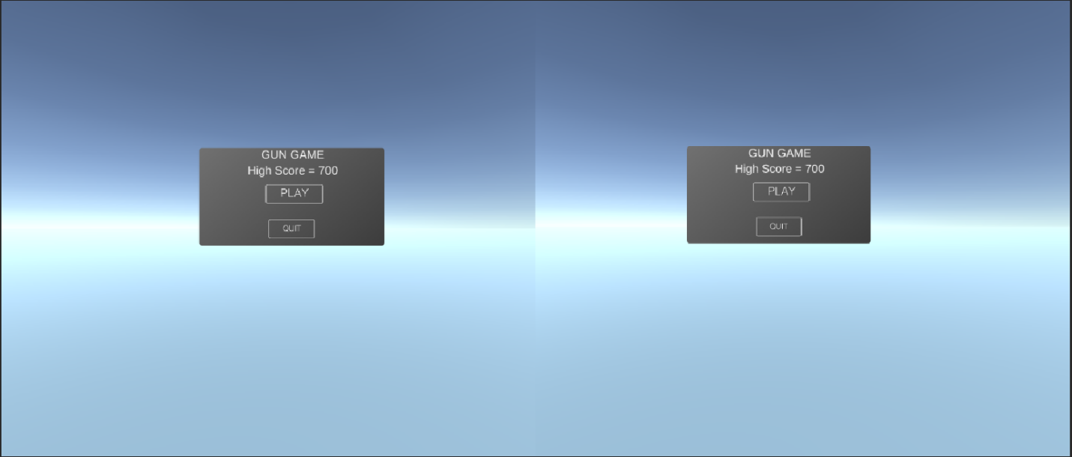
through the Unity Package Manager to streamline level design workflows.
Setting up the Environment:
Create a New Unity Project: Open Unity Hub, create a new project, and select the 3D template. Choose a project name and location on your system.
Import Necessary Packages: Once inside the Unity editor, navigate to the Package Manager window. Install the Standard Assets, Cine machine, and Pro Builder packages if they're not already included in your project.
Set Up Scene and Assets: Design your game scene by importing assets such as terrain, props, and character models. Utilize Pro Builder to create custom level geometry or modify existing meshes.
Scripting: Begin scripting enemy behaviors, player controls, weapon mechanics, and game logic using C# scripts. Attach scripts to appropriate Game Objects to define their functionality within the game.
Testing and Iteration: Test your game frequently to identify bugs, refine gameplay mechanics, and optimize performance. Use Unity's built-in debugging tools to diagnose issues and make necessary adjustments.
Conclusion:
With Unity 3D, an appropriate IDE, and essential Plugins/packages installed, you're ready to embark on the exciting journey of Gun Game development. Follow these setup instructions to create a captivating gaming experience where players must eliminate enemies to emerge victorious.

Slide 9
3. Scene Setup for Gun Game Development
1. Terrain Creation:
Create a new terrain by selecting Game Object -> 3D Object -> Terrain.
Use the Terrain Tools to sculpt the terrain to fit your level design, including hills, valleys, and obstacles.
Apply textures and foliage to the terrain to enhance visual appeal and provide cover for players and enemies.
2. Lighting Setup:
Add directional light to simulate sunlight and create shadows in the scene.
Adjust light settings such as intensity, color, and shadows to achieve the desired ambiance.
Utilize additional light sources (point lights, spotlights) to illuminate specific areas or enhance visual effects.
3. Camera Setup:
Create a new camera Game Object to serve as the player's perspective.
Adjust the camera's position, rotation, and field of view to provide optimal visibility and gameplay experience.
Implement camera controls (e.g., mouse or joystick input) to enable players to move the camera view freely or focus on specific targets.
4. Environment Assets:
Populate the scene with environmental assets such as buildings, foliage, rocks, and other props to create a realistic and immersive setting.
Place interactive objects like doors, switches, or destructible elements to add depth to the gameplay and encourage exploration.
5. Player and Enemy Spawning:

Slide 10
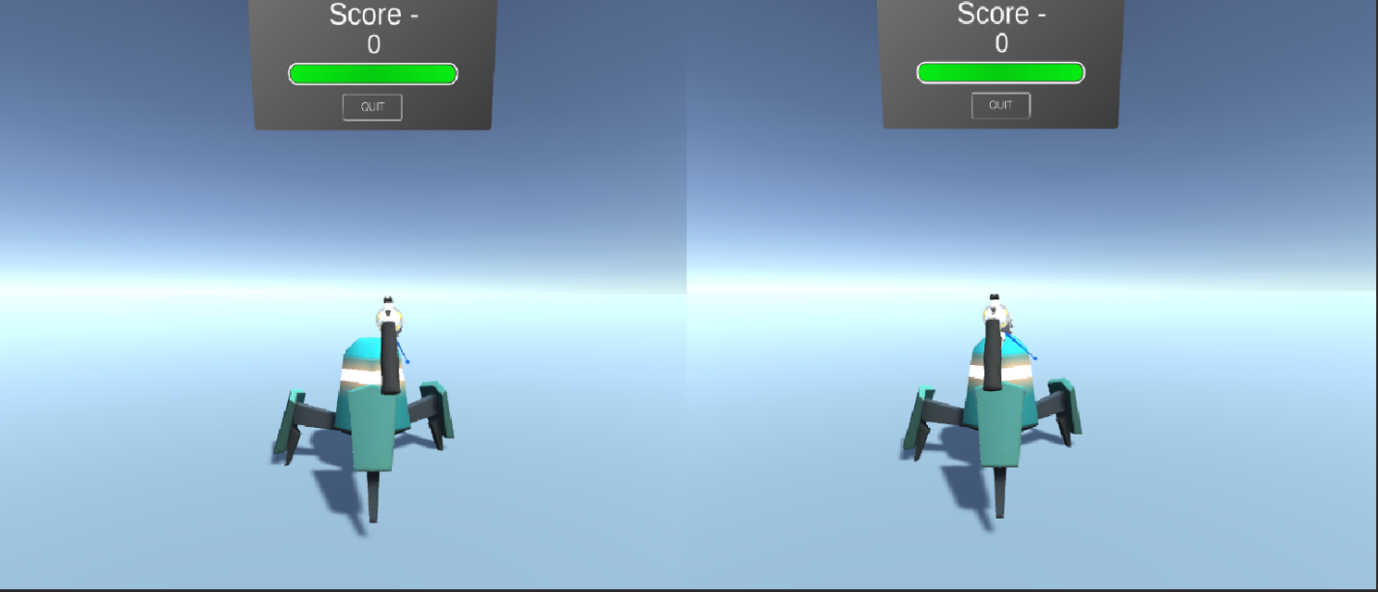
Position spawn points for players and enemies strategically throughout the level.
Ensure spawn points are placed in safe locations for players and provide sufficient cover to avoid spawn camping.
Implement spawning logic to dynamically generate enemies based on player proximity or predefined triggers.
6. Weapon and Ammo Placement:
Scatter weapon pickups and ammo crates across the level to supply players with firepower and ammunition.
Distribute weapons strategically to encourage exploration and risk-reward decisions.
Use scripting to respawn weapons and ammo over time or upon player interaction.
7. Navigation and Pathfinding:
Set up navigation meshes or waypoints to enable AI-controlled enemies to navigate the environment intelligently.
Implement pathfinding algorithms (e.g., A* algorithm) to calculate optimal routes for enemies to pursue players or patrol designated areas.
8. Audio Integration:

Slide 11


Slide 15


Slide 19


Slide 23


